Slide 1


Electronic Commerce
The impact of local and global regulations on eCommerce
Week 5: Seminar 4
Group ZF
TEAM ZF

Slide 2
Personal Data Protection
Electronic Communications and Transactions Act
Regulations around
Consumer Protection
Electronic Communications
Electronic Transactions
Cybersecurity
Cross-border data transfer
Aim at
Facilitating electronic transactions
Promote legal certainty
Compliance with international standards
Safe environment for consumers, businesses, and government
Created
Cyber Inspectors
Enforces the law

Slide 3
Personal Data Protection
Protection of Personal Information Act
Regulations around
Right to privacy
Personal Information
Safeguards
Minimum requirements
Codes of conduct
Aim at
Protecting consumers
Providing remedies
Regulating the manner of processing personal information
Created
Information Regulator
Oversees compliance of public and private bodies
Investigates transgressions

Slide 4
Personal Data Protection
National Cybersecurity Policy Framework
Regulations around
Cybersecurity
Aim at
Protecting the digital infrastructure
Implementing security policies
Fighting cyber crime
Created
Cyber Inspectors
Enforces the law

Slide 5
Internet
Information Regulator & Cyber Inspectors
Hackers & Snoopers
Government

Slide 6

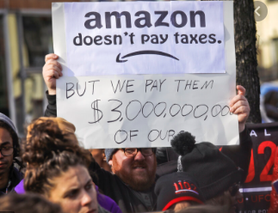
Regulations in the VAT Act and Income tax act have been aimed towards levelling the playing field between foreign and local suppliers in Ecommerce in South Africa.
Prior to this, taxation laws that applied to local suppliers did not apply to foreign suppliers, leading to an unfair market.
E-business supplying services to South Africa must pay a standard rate of 15%, if the payment originates from a South African bank.
Local importers are not required to register as VAT venders unless they exceed a R50000 transaction threshold within a month

Slide 7

CREDIT
Credit is an effective but risky method of increasing the purchasing power of the online consumer and the profit generated by a business.
Misunderstandings can arise in credit agreements, pre-contract disclosures, post-contractual agreements and early settlements.
As such, Section 75 of The National Credit Act outlines regulations that protect the consumer and the supplier, settling any disputes.
Any site providing any form of credit in South Africa requires licensing from the Office of Fair Trading

Slide 8

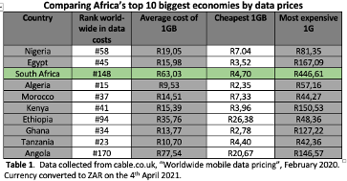
Broadband data prices and demand
A brief discussion
The ineffective regulation of mobile data price market has been one the biggest barriers of entry for most South Africans and a hindrance to demand for Ecommerce.
This could change however after a draft document of Mobile Broadband Services Regulations was published in 2021 by the Independent Communications Authority of South Africa outlining regulations that are aimed at reducing data costs for consumers.
Contents Title

Slide 9

Global Regulations
GDPR
General Data Protection
Regulation
Countries with GDPR-like Laws
EU Law (2016)
Data Protection and Privacy
Transfer of personal data outside the EU
Brazil – LGPD
Australia – Privacy Amendment
Japan – Act on Protection of Personal Information
E-Commerce Law
of the People’s Republic of China
China (2018)
Comprehensive – variety of legal subjects relevant to e-commerce
USA
CCPA
California Consumer Privacy Act
No data privacy law applied on a federal level

Slide 10
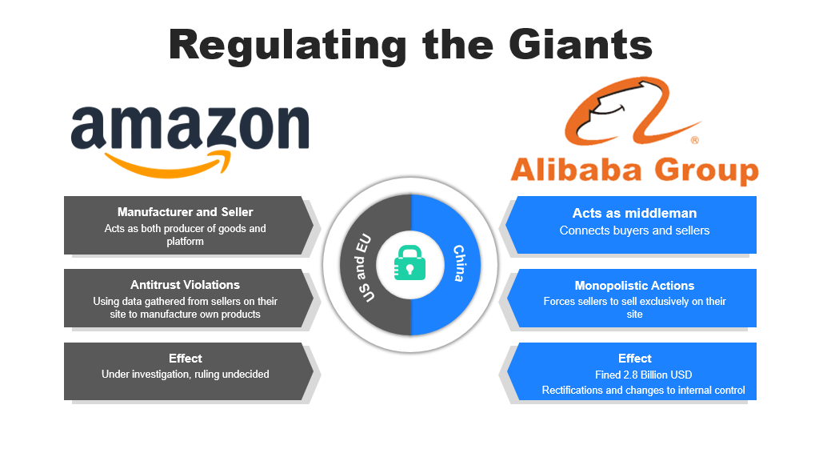


Regulating the Giants
China
US and EU
Manufacturer and Seller
Acts as middleman
Get a modern PowerPoint Presentation that is beautifully designed.
Connects buyers and sellers
Antitrust Violations
Monopolistic Actions
Get a modern PowerPoint Presentation that is beautifully designed.
Get a modern PowerPoint Presentation that is beautifully designed.
Effect
Effect
Get a modern PowerPoint Presentation that is beautifully designed.
Get a modern PowerPoint Presentation that is beautifully designed.

Slide 11









Competition Commission South Africa
Who?
Competition Commission of South Africa is empowered by the Competition Act to act as the regulatory body for business practices in South Africa...
They have recently initiated an inquiry into online intermediation platforms that operate in South Africa
Inquiry includes:

Slide 12
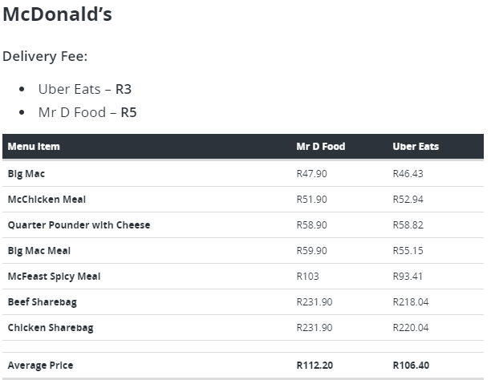
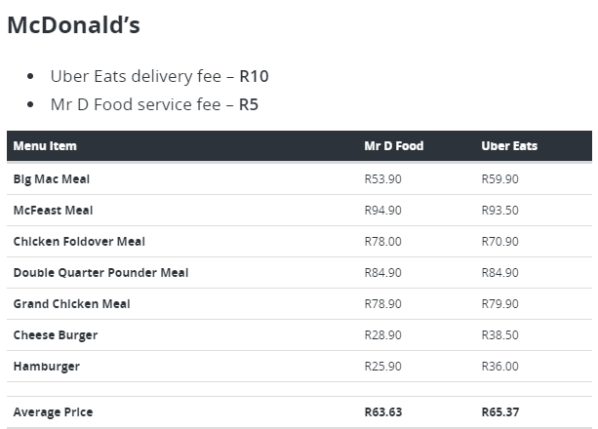


Regulating the sale prices of Goods

Slide 13
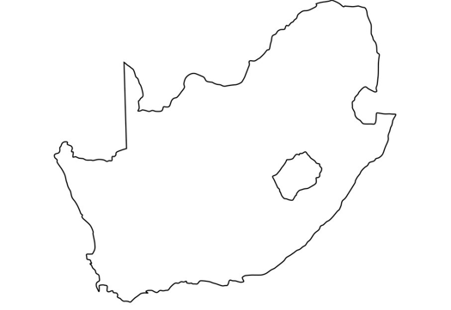

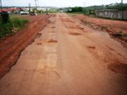

Regulation Against Discrimination
CLASSISM
Not offering delivery to rural and remote areas or
Charging a surplus on the standard delivery fee
Example of a Lack of infrastructure
Lack of well-maintained tar roads, high risks to delivery vehicles
Areas that are congested with shacks and a lack of "proper" buildings

Slide 14
Conclusion
an increased drive towards education; and equitable access to digital
infrastructure.
more coordination between governmental levels,
the public and businesses
more
accountability for government and regulatory bodies
producing a sufficient supply of skilled technicians to build and maintain infrastructure

